Slide 1
CUREs in Laboratory Classes
Bean Beetle Microbiome Project
2023 Workshop

Slide 2
What are the essential components of a course-based undergraduate research experience (CURE)?

Slide 3
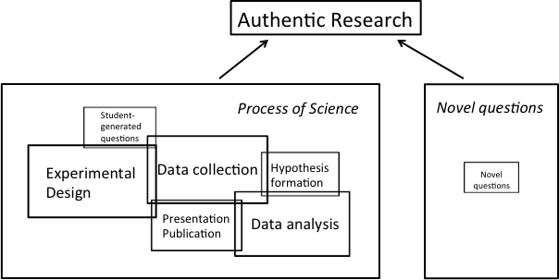
Two Modes of Authentic Research
Spell, et al. Redefining Authentic Research Experiences in Introductory Biology Laboratories and Barriers to Their Implementation. CBE-LSE 2014

Slide 4
Other Definitions of CUREs
Use of Scientific Practices
Discovery
Broadly relevant or important work
Iteration
Collaboration
Auchincloss et al., CBE 2014

Slide 5
Common Elements in CUREs
Staub et al. CUR Quarterly 2016

Slide 6
Conclusions of Definitions
no one clear definition
a given CURE may favor one conception

Slide 7
Different Paths to a CURE
Student Defined Loosely Bounded by discipline
Scaffolded from Guided-Inquiry
Student Defined but Bounded by Faculty
Student Defined but Bounded by Faculty Selected Publication
Faculty Defined
(Low) Degree of Student Control (High)

Slide 8
Bean Beetle Microbiome Project
Use of Scientific Practices
Discovery
Broadly relevant or important work
Iteration
Collaboration

Slide 9
Bean Beetle Microbiome Project
Novel Questions
Student Generated OR Instructor Proposed
Experimental Design
Data Collection
Data Analysis
Presentation and Publication

Slide 10
Bean Beetle Microbiome CURE Implementations
Student Defined Loosely Bounded by discipline
Scaffolded from Guided-Inquiry
Student Defined but Bounded by Faculty
Student Defined but Bounded by Faculty Selected Publication
Faculty Defined
(Low) Degree of Student Control (High)

Slide 11
Do CUREs Improve Student Outcomes?
Effects of CURE modules at Emory University

Slide 12
Three multi-week CURE modules
Experimental evolution of C. elegans to pathogenic bacteria
Effects of ploidy on mutation rates in Candida yeast
Bean beetle microbiome

Slide 14
